Slide 1



Graphic from ilifejourney.files.wordpress.com
Behavior Change, One HEALTH MODULES

Slide 2
Introduction
Behavior Change, One Health Modules

Slide 3
Module competencies
Competency #1
  Explain behavior modification theories and change management concepts
Competency #2
  Adapt models for individual behavior change for OH initiatives across a range of stakeholders
Competency #3
  Demonstrate cultural competency and professionalism in leading change
Competency #4
  Design behavior modification strategies for OH interventions in communities

Slide 4
Module overview
Time/Length | Topic
-- | Prework
30 minutes | Introduction
60 minutes | Introduction to Behavior Change
60 minutes | Moving from Professional Centered to Patient Centered Behavior Change
60 minutes | Health Belief Model
120 minutes | Two Models for Patient Centered Change: Motivational Interviewing and RULE
120 minutes | Expanding the Motivational Interviewing and RULE Models beyond a Health Care Setting
90 minutes | Two Models of Organization and Community Change: Kotter and Lewin
150 minutes | Behavior Change in One Health Interventions
60 minutes | Module Review

Slide 5

When was the last time
you did something
for the first time

Slide 6
Professional-Directed vs.
Patient-Centered Behavior Change
Behavior Change, One Health MODUELS

Slide 7
Practice exercise
In trios randomly select a role
Two 10-minute rounds
  Patient and Change Agent 1
  Patient and Change Agent 2
After each round
  Patient writes down on a scale from 1 to 10 how likely they are to change their behavior
  Discuss what was effective about the Change Agent’s approach
  Discuss what was not as effective about the Change Agent’s approach

Slide 8
What do you think?
Which approach was most effective?
Which approach is most natural to you?
What skills do both approaches have in common?
What skills did you see Change Agent #1 using?
What skills did you see Change Agent #2 using?
Which from a patient’s point of view is most effective?

Slide 9
Models of Patient-Centered Behavior Change
Health Belief Model
Behavior Change, One Health Course

Slide 10
The Health Belief Model
Developed by a group of social psychologists at U.S. Public Health Service in the 1950s.
Derived from psychological and behavioral theory.
Objective was to explain why people were not participating in a tuberculosis screening (disease detection).
One of the first models developed to specifically address health-related behaviors.
The model has been modified to apply to a greater amount of situations.
Notes:
The Health Belief Model (HBM) is a psychological health behavior change model developed to explain and predict health-related behaviors, particularly in regard to the uptake of health services. It was developed in the 1950s by social psychologists at U.S Public Health Service in order to better understand the widespread failure of screening programs for tuberculosis. The model was originally designed to predict behavioral responses to treatment received by acutely or chronically ill patients, but in more recent years the model has been used to predict more general health behaviors. The Health Belief Model suggests that your belief in susceptibility and severity of the threat, combined with your belief in the effectiveness and ease of the proposed behavior change will predict the likelihood of you adopting the new behavior.

Slide 11
The Health Belief Model
Ultimately, an individual’s course of action depends on an individual’s perceptions of the benefits and barriers related to health behavior.

Slide 12
Health belief Model Constructs
For a patient to change behavior, patient must:
Know that they are susceptible to or have a particular health condition
Believe that having the condition is serious and harmful
Perceive that the benefits of changing their behaviors outweighs the challenges
Feel that there are treatment options
Feels a ‘call to action’ to spark the change
Perceives that s/he can successfully preform the behavior
Notes:
Read definition.

Slide 13

Health belief model:
Six Constructs
Patients’ perception that they are susceptible to or have a particular health condition.
Perceived Susceptibility
Notes:
Perceived Susceptibility - This refers to a person's subjective perception of the risk of acquiring an illness or disease. There is wide variation in a person's feelings of personal vulnerability to an illness or disease.
People can vary greatly in regards to their perception of susceptibility. On one extreme are individuals who completely deny any possibility of acquiring a disease and on the other extreme are people who are very fearful of the disease and assume that they will probably acquire it. The more susceptible a person feels to a disease or illness, the greater the likelihood that they will take preventive measures.
Example: Consume safe water vs unfiltered tap water

Slide 14
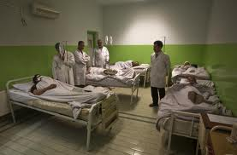
Health belief model:
Six Constructs
Patients’ belief that having the condition is serious and harmful.
Perceived Severity
Notes:
Perceived severity - This refers to a person's feelings on the seriousness of contracting an illness or disease (or leaving the illness or disease untreated). There is wide variation in a person's feelings of severity, and often a person considers the medical consequences (e.g., death, disability) as well as social consequences (e.g., family life, social relationships) when evaluating the severity.
Individuals perceive the severity of a disease or illness differently. Some might evaluate the temporary or permanent nature of the condition and its potential for death. Some individuals will define severity beyond the impact of the disease on themselves- but evaluate its severity based on how it will affect their family, their job, and their relationships.
Example: moderate to high-moderate alcohol use can have limited short term negative effects, yet can lead to significant medical and social consequences over time.

Slide 15
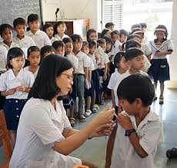
Health belief model:
Six Constructs
Patients’ perception that actions will result in a benefit (a reduction in the threat of the illness or disease or the curing if the illness or disease).
Perceived Benefit
Notes:
Perceived benefits – This refers to a person’s perception of the effectiveness of actions available to reduce the threat of the illness or diseases or to treat/cure the illness or disease. The course of action a person takes in preventing/curing an illness is dependent on consideration and evaluation of the perceived benefits. A person is more likely to take an action if s/he believes the action will be beneficial.
Example: Breast self-examination and early cancer detection.

Slide 16

Health belief model:
Six Constructs
Patients’ perception that the benefits of changing their behavior will outweigh the challenges and obstacles of making the change.
Perceived Barriers
Notes:
Perceived barriers – This refers to a person’s feelings on the obstacles to performing a recommended health action. There is a wide variation in a person’s feelings of barriers which lead to an internal cost-benefit analysis. A patient will weight the effectiveness of the actions against the perceptions that it may be expensive, dangerous, unpleasant, time-consuming, and/or inconvenient.
Example: Inconvenient, time-consuming, and/or expensive

Slide 17

Health belief model:
Six Constructs
Patient feels a ‘call to action’ to spark the change process.
Cue to Action
Notes:
Cue to action - This is the stimulus needed to trigger the decision-making process to accept a recommended health action. These cues can be internal (e.g., chest pains, wheezing, etc.) or external (e.g., advice from others, illness of family member, newspaper article, etc.).

Slide 18

Health belief model:
Six Constructs
Perceives, or has the confidence, that s/he can successfully preform the behavior
Self-Efficacy
Notes:
Self-efficacy - This refers to the level of a person's confidence in his or her ability to successfully perform a behavior. This construct was added to the model most recently in mid-1980s.

Slide 19
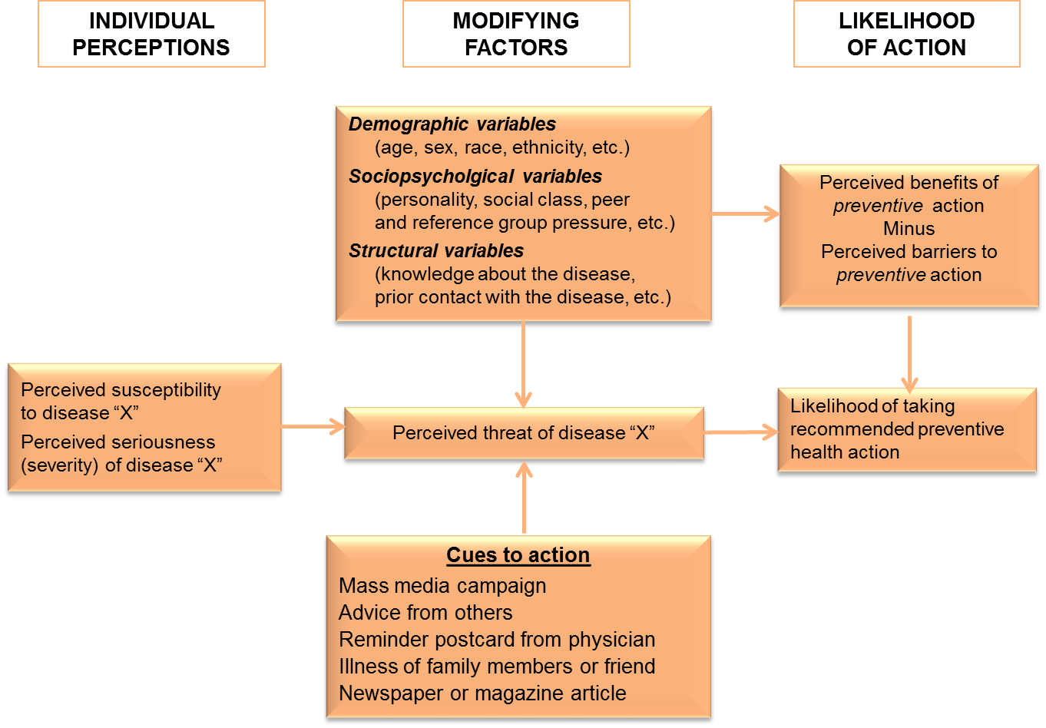
Modifying Factors Impacting Likelihood for Change
Notes:
Read final definition.

Slide 20
What do you think?
What do you see as the strengths of the health belief model?
What do you see as the limitations of the health belief model?
Notes:
Read final definition.

Slide 21
Making the change… Quitting Smoking |  | Not making the change… Continuing to Smoke
Benefits | Costs | Benefits | Costs
Won’t cough in the morning | Stressful to quit | Helps with stress | Worry about health
More energy | Gain weight | Enjoy smoking with friends | Social Stigma
Save money | Lose another pleasure |  | Ruins skin
Better role model for kids | Withdrawal symptoms |  | Cannot smoke at work or in the house
 |  |  | Get winded and cannot do some activities

Slide 22
Models for Patient-Centered Behavior Change
Readiness to Change and Motivational Interviewing
Behavior Change, One Health Modules

Slide 23
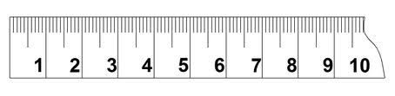
Importance Ruler
Not
Important
Somewhat Important
Very Important
Confidence Ruler
Not at all
Confident
Somewhat Confident
Very Confident
Readiness to Change Ruler
Not
Ready
Somewhat Ready
Very
Ready

Slide 24
What do you think…
Given what you read about Motivational Interviewing:
How do you think asking about readiness or importance or confidence to change will help people change their behavior?
How do you think you might use this?

Slide 25
Spirit of Motivational Interviewing: ACE
A Autonomy | Honor the patient’s choice about change. Often, acknowledging a persons’ right and freedom to choose NOT to change, frees them up to consider change.
C Collaboration | Create a safe, collaborative environment and encourage/facilitate joint decision-making and problem solving.
E Evocation | Evoke or draw out patient’s own ideas and motivation for change. Understand their own perspectives, uncover values and goals that support health behavior change.
Guiding Principles of Motivational Interviewing: RULE
R Resist the Righting Reflex | People generally believe what they hear themselves say they should do & react in opposition of what others tell them to do. The patient is his/her own expert.
U Understand your Patient’s Motivations | It is the patient’s own reasons for change, and not ours, which are most likely to trigger behavior change.
L Listen to your patient | When it comes to behavior change, the answers most likely lie within the patient and finding them requires listening and discovery (like panning for gold).
E Empower your Patient | The patient who is active in the consultation, thinking aloud about the way and how of change, is more likely to follow through.
Notes:
INSERT DEFINITIONS O

Slide 26
Key skills of Motivational Interviewing
Empathizing
Asking Questions
Listening
Informing

Slide 27
Motivational interviewing and rule require:
Using open-ended questions to explore patients feelings
Affirming comments and behaviors that show signs of increased interest in change
Exploring the benefits and drawbacks of making the change
Having the patient envision a future and ask what needs to happen to achieve that future

Slide 28
Two Models for Organization
and Community Change:
Kotter and Lewin
Behavior Change, One Health Course

Slide 29
Kotter’s 8 essential steps for change
Establishing a Sense of Urgency
Creating a Guiding Coalition
Developing a Vision & Strategy
Communicating the Change Vision
Empowering Broad-Based Action
Generating Short-Term Wins
Consolidating Gains & Producing More Change
Anchoring New Approaches in the Culture

Slide 30
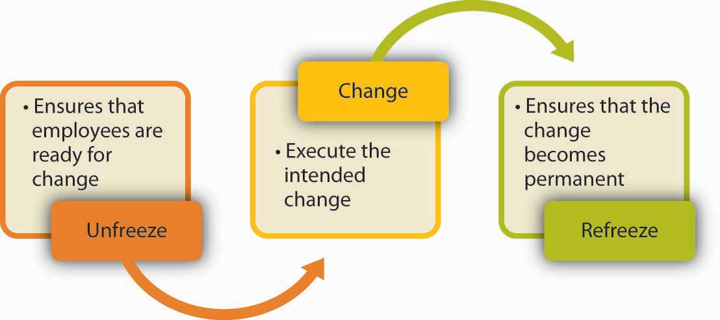
Lewin’s Three Step Model for Change

Slide 31
What do you think?
What they liked about each model.
What they need to study more about each model.
Are the models exclusive of each other? Complimentary?

Slide 32
Expanding Patient-Centered Behavior Change Models Beyond the Human Health Context
Behavior Change, One Health Course

Slide 33

How would the health belief model work in your region, culture, or discipline?
How would you modify Motivational Interviewing and RULE to work in your region, culture or discipline?

Slide 34
What do you think?
Are there any similarities in your models that we see cutting across regions/cultures or disciplines?
What are the differences across regions, cultures and disciplines that we need to be aware of and sensitive to when working as part of a One Health team?
How do you think understanding these similarities and differences in approach will help you in your work?

Slide 35
Build your toolkit
As a member of a One Health Team, what do you feel is your role in changing people’s behaviors?”
Create your model for behavior change in your discipline and as part of a One Health team.

Slide 36
Behavior Change in One Health Interventions
Behavior Change, One Health Course

Slide 37
What do you think?
Think of a situation that you have faced or might face that involves changing individual and/or community behaviors. What is your model for change?
Directions:
Spend the next 30 minutes reflecting on your ideas from the previous session in which you created your own personal model for behavior change and the two models for community change – Kotter and Lewin.
Summarize your model of a flipchart. At the end of the hour, we will share our models.

Slide 38
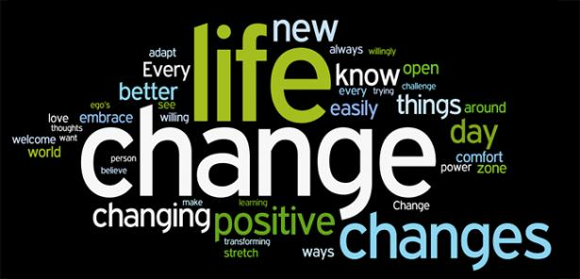
Graphic from www.payology.com

Slide 39
Learning Reflections and Evaluation
Behavior Change, One Health Course

Slide 40
One thing..
That you liked/felt was a strength of the module.
That you would suggest we change.
Thank you.

Slide 41
This publication was made possible in part through the support provided by the United States Agency for International Development. The opinions expressed herein are those of the author(s) and do not necessarily reflect the views of the US Agency for International Development or the US Government. USAID reserves a royalty-free nonexclusive and irrevocable right to reproduce, publish, or otherwise use, and to authorize others to use the work for Government purposes.

