Slide 1



Source: leadershipcouples.com
Leadership, One Health Course

Slide 2
Introduction
leadership, One Health Course

Slide 3
Module competencies
Competency #1
  Develop a shared vision of leadership
Competency #2
  Demonstrate an understanding of effective leadership in the One Health Context
Competency #3
  Understand and adapt personal leadership styles
Competency #4
  Develop and apply strategies for engaging and empowering others to take collective actions

Slide 4
Module overview
Time/Length | Topic/Activity
140 Minutes + | Introduction to Leadership
160 Minutes | The Role of Leadership in One Health
135 Minutes | Leadership Styles
60 Minutes | Adapting Your Leadership Style – Working Collectively
205 Minutes | Engaging and Empowering Others to Take Action: Part I
165 Minutes | Engaging and Empowering Others to Take Action: Part I

Slide 5
What is leadership
A process of social influence in which one or more people can enlist the aid and support of others in the accomplishment of a common task. (Wikipedia)
Leadership is the art of leading others to deliberately create a result that wouldn’t have happened otherwise. (A Blog Post)
Leadership is the capacity to translate vision into reality. (Warren Bennis)
Leadership is influence – nothing more, nothing less. (John Maxwell)
Leadership is an opportunity to serve. It is not a trumpet call to self-importance. (J. Donald Walters)

Slide 6
A leader is…
A leader is best when people barely know he exists, when his work is done, his aim fulfilled, they will say: we did it ourselves. (Lao Tzu)
A good leader can engage in a debate frankly, thoroughly, knowing that at the end he and the other side must be closer, and thus emerge stronger. (Nelson Mandela)
A leader is one who knows the way, goes the way, and shows the way. (John Maxwell)

Slide 7
What leadership is not…
Seniority/experience
One’s position or title
Management

Slide 8
Is there a difference between Leadership and a Leader?

Slide 9
The Role of Leadership in One Health
leadership, One Health Course

Slide 10
“One Health is the integrative effort of multiple disciplines working locally, nationally, and globally to attain optimal health for people, animals, and the environment. Together, the three make up the One Health triad, and the health of each is inextricably connected to the others in the triad. Understanding and addressing the health issues created at this intersection is the foundation for the concept of One Health.”

Slide 11
One health leadership domains
Shared Vision
Strategic and Critical Thinking
Decision Making
Collaborative Solutions
Team Commitment

Slide 12
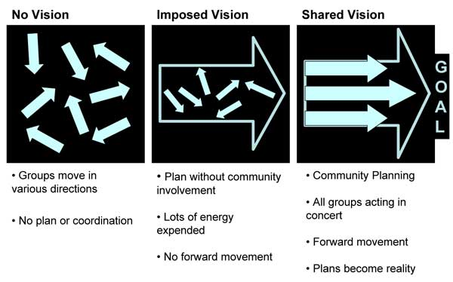
Shared vision

Slide 13
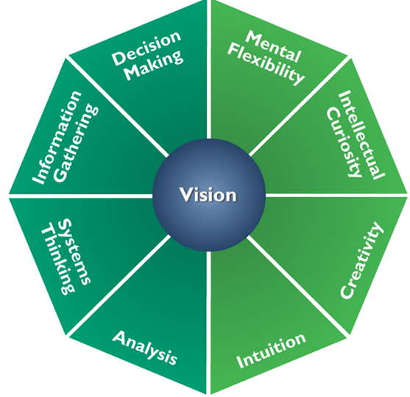
Strategic and critical thinking
Notes:
Instructor should comment on the meaning of the two shades of green in this slide.

Slide 14
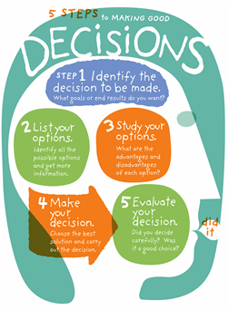
Decision making

Slide 15
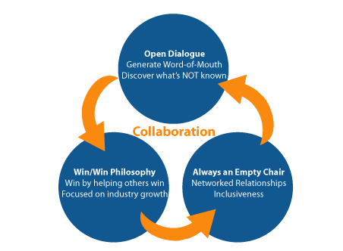
COLLABORATIVE SOLUTIONS

Slide 16
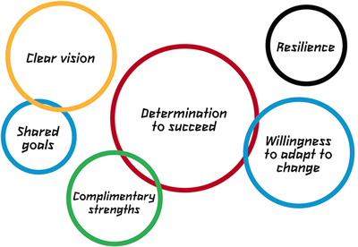
TEAM COMMITMENT
Notes:
The logic intersection of the circles isn’t immediately apparent to me. If there is an inherent meaning that should be made clear by the instructor. Also true in the reverse.

Slide 17
LEADERSHIP STYLES
LEADERSHIP, One Health Course

Slide 18
LEADERSHIP THEORIES
Trait theories.
Behavioral theories.
Contingency theories.
Power and influence theories.

Slide 19
LEADERSHIP STYPLES
Directive leadership.
Bureaucratic leadership.
Charismatic leadership.
Participative leadership.
Delegative leadership.
People/relations-oriented leadership.
Servant leadership.
Task-oriented leadership.
Transactional leadership.
Transformational leadership.

Slide 20
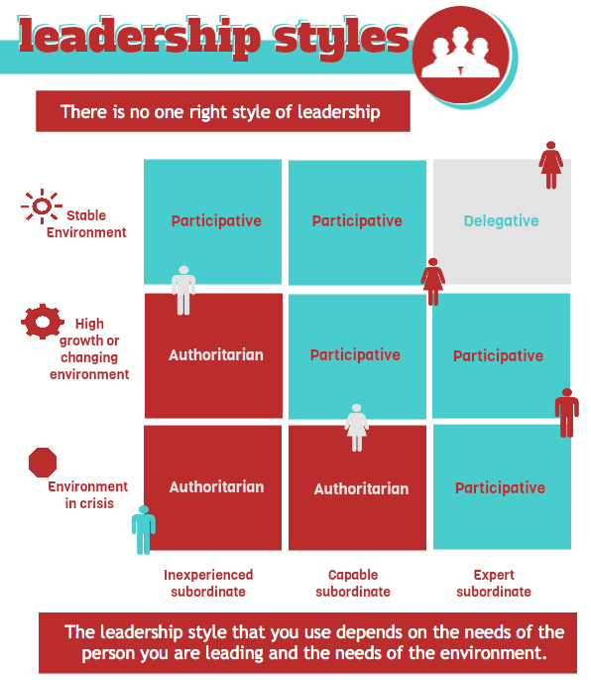
Notes:
Instructor should interpret this slide reminding participants that Authoritarian has been updated to Directive which is used in most of the other materials in this module. Attribution for this diagram???

Slide 21
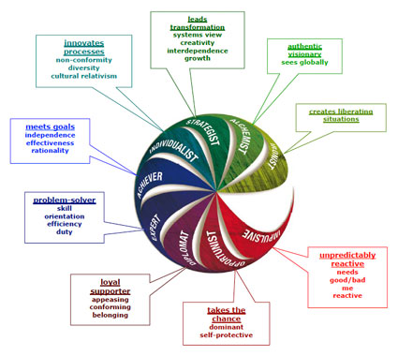
Notes:
Attribution??

Slide 22
As a student of leadership
Each of the styles has strengths and weaknesses and maybe be more effective or less effective in a particular situation.
You can become a more effective leader by learning about these core leadership theories, and understanding the tools and models associated with each one.

Slide 23
ADAPTING YOUR
LEADERSHIP STYLE
LEADERSHIP, One Health Course

Slide 24
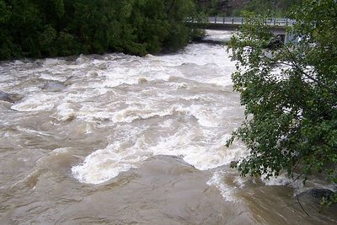
Toxic River
Source: www.advrider.com

Slide 25
Toxic River
The paper is a special stepping stone that will allow you to cross the river.
The stepping stones must be touched at all times when they are placed in the river.
If they are not being touched, they will be swept away by the rushing river.
You cannot slide the stones to move forward.
ALL MEMBERS OF THE GROUP (CLASS) MUST CROSS TO BE SUCCESSFUL!

Slide 26
What dID you OBSERVE?
What happened? What did you notice about how people crossed the river?
What were the leadership dynamics?
What did the leader(s) do that was effective? Not as effective?
As a team member, how did you communicate to leadership your needs?
Did you feel you were competing with the other teams to be the first to cross? Or did the teams collaborate?
What will you do differently next time…as a leader? As a follower?

Slide 27
Engaging and Empowering
Others to Take Action
Leadership, One Health Course

Slide 28
JAKARTA, Indonesia (AP) — Villagers and park rangers are using torches and firecrackers to herd out about 20 endangered Sumatran elephants that wandered into an Indonesian village in search of food.
Local forestry office head Warsito said the elephants entered Braja Indah village in Lampung province Thursday and were still there Friday night.
More than 200 elephants live within Way Kambas National Park near the village. Fewer than 3,000 Sumatran elephants are left in the wild, and environmentalists warn they'll go extinct without protection.
Warsito told El-Shinta radio that a negotiation is ongoing to compensate villagers since the expulsion route passes through their farms.
At least five elephants have been poisoned since April, while in December a farmer was trampled to death. Villagers say they'll kill the elephants if authorities don't protect their farms.

Slide 29
What’s the issue?
You have 10 minutes to brainstorm a list of types of stakeholders in this example and two or three issues that would be important to each stakeholder type
We will now share our thoughts about stakeholders and issues specific to each type
Next, take 2 minutes to write down our responses to the question
“What are the underlying issues impacting our community?”
What similarities/differences did you hear between the responses?
      What caused some of us to have similar interpretations?
      Why are other interpretations so different?
      What does this exercise begin to illustrate about stakeholder engagement?

Slide 30

Collective action
Behavior or actions of a group working toward a common goal. When individuals engage in collective action, the strength of the group's resources, knowledge and efforts is combined to reach a goal shared by all parties.”
Image source: webpages.scu.edu

Slide 31
Stakeholder engagement assumptions
People already know their issues and have the means to address these issues. They need to be involved in the decision-making process.
Involving stakeholders from the beginning of a process leads to more effective and sustainable solutions.
Transparency and dialogue is critical to success.
You can use the opinions of the most powerful stakeholders to shape your projects at an early stage. Not only does this make it more likely that they will support you, their input can also improve the quality of your project

Slide 32
Stakeholder engagement assumptions
Gaining support from powerful stakeholders can help you to win more resources – this makes it more likely that your projects will be successful
By communicating with stakeholders early and frequently, you can ensure that they fully understand what you are doing and understand the benefits of your project – this means they can support you actively when necessary
You can anticipate what people's reaction to your project may be, and build into your plan the actions that will win people's support.

Slide 33
Stakeholder engagement process
Define the Problem
Identify Stakeholders
Conduct Stakeholder Analysis
Co-Create Vision, Goals, Plan
Decide on Roles and Responsibilities
Implement and Adjust
Notes:
Define the problem
Identify your stakeholders
Conduct a stakeholder analysis
Co-create vision, goals, objectives, solutions and a plan.
Decide on roles and responsibilities in implementation.
Implement and adjust as needed.

Slide 34
Stakeholder engagement methods
Interviews
Focus Groups
Surveys
Citizens’ Juries
Town Meetings
Conferences/Workshops
DELPHI
Nominal Group Technique
Modeling
Scoping Study

Slide 35
Questioning techniques
Open-ended
Closed
Funnel
Probing
Leading

Slide 36
Listening skills - rasa
Receive – sit back and actually listen! Turn your commentary off.
Appreciate – utilize body language and verbal signals to show you are listening and understanding
Summarize – repeat back what you have heard to demonstrate your understanding
Ask – follow up with questions that build on what they have said or transition to another topic if needed

Slide 37
Engaging and Empowering
Others to Take Action
leadership, One Health Course

Slide 38
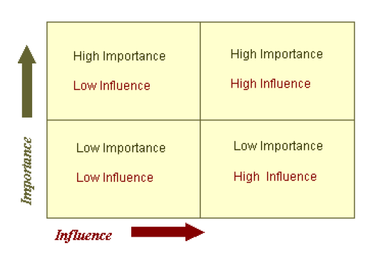
Stakeholder analysis

Slide 39
engagement
Get stakeholders participating early on in the process.
Be clear about the objective of the engagement and strive for transparency with your stakeholders.
Communicate frequently and utilize social networks/existing structures.
Find out what is working as well as their challenges – build from strengths if possible.
Build a sense of urgency and form a guiding coalition to help move the change forward.

Slide 40
empowering
Listen and acknowledge stakeholder concerns, ideas, etc.
Put decision-making in the stakeholders hands.
Facilitate the process, help to identify and support leaders as needed.
Identify quick wins so that people see success/progress early on.

Slide 41
influencing
Understand and speak to what is important from their perspective
Identify common objectives you share
If possible, show rather than just tell – use examples, demonstrations, etc. to influence people in the head as well as the heart .

Slide 42
Module Review
leadership, One Health Course

Slide 43
One thing..
That you liked/felt was a strength of the module.
That you would suggest we change.
Thank you.

